Slide 1
IASO BIO
Feb 2026

Slide 2

Disclaimer
This presentation has been prepared by Nanjing IASO Biotechnology Co., Ltd (hereinafter referred to as the “Company”) for reference purposes only. By reviewing or obtaining the information contained in this material, you hereby acknowledge and agree that the company, or any of its directors, shareholders, employees, agents, affiliates, consultants or representatives, makes no representations, warranties or undertakings, express or implied. And should not rely on the accuracy, fairness, completeness or correctness of the information or opinions provided or contained in this presentation. The company or any of its directors, shareholders, employees, agents, affiliates, consultants or representatives are not (by negligence or otherwise) caused by any information provided or contained in this presentation or other reasons related to this presentation. Any liability for any loss. Information provided or contained in this presentation is subject to change without notice and is not guaranteed.
No part of this presentation constitutes a basis or reliance on any contract or investment decision relating to any securities or otherwise. This presentation does not contain all relevant information about the company or its securities, especially information relating to the risks and special considerations of investing in the company’s securities. Nothing contained in this presentation shall be a commitment or representation of the company's past or future performance. Past performance is not guaranteed or predicts future performance. You acknowledge that any evaluations you may have about the Company will be independent of this presentation and that you will be solely responsible for your own assessment of the company's market and market position, and that you will conduct your own analysis and form your own responsibilities for the future performance of the company's business.
Certain statements in this presentation and other statements that the company may make are forward-looking statements. These statements reflect the company's intentions, beliefs or current expectations for the future. Such statements may be identified by the words "expect", "plan", "will", "estimate", "forecast", "intended", "expected", "believe", "confident" or similar Words. These forward-looking statements are not guarantees of future performance, but are based on assumptions about the company’s operations and other factors, many of which are beyond the company’s control and, therefore, actual results may differ materially from these forward-looking statements. The company or any of its affiliates, consultants or representatives has no obligation or commitment to modify forward-looking statements to reflect future events or circumstances.
The information contained in this document is highly confidential and is provided solely for the purpose of providing you with information and for your use only in connection with the use of this presentation. The information contained in this document may not be reproduced, redistributed or disclosed to any other person in whole or in part. This presentation may not be forwarded, distributed or reproduced in whole or in part.
Your viewing, access or participation in this presentation is the basis for your knowledge and confidentiality of the contents of this presentation and these materials. You agree not to remove these materials or any materials provided in connection with the conference room in which the document is provided. You further agree that you may not photograph, reproduce or otherwise reproduce this presentation or transfer it to any other person for any purpose during this briefing or in a conference room. At the end of this presentation, you must return this presentation and all other materials provided in connection with the company. Your access to, access to, or participation in this presentation is hereby agreed to be bound by the above limitations.

Slide 3
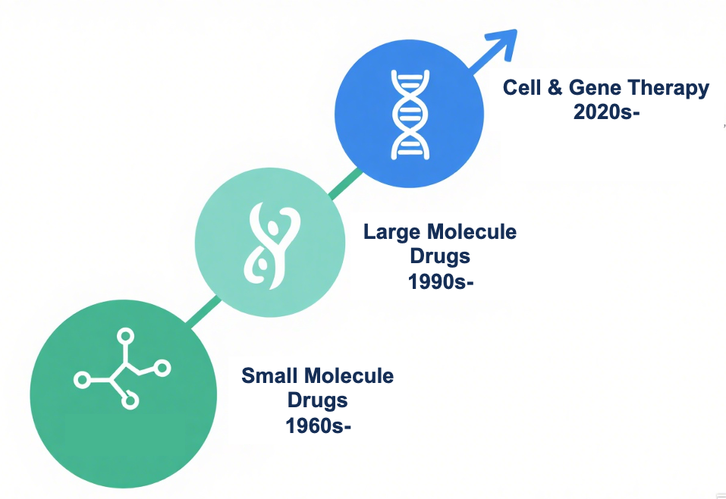
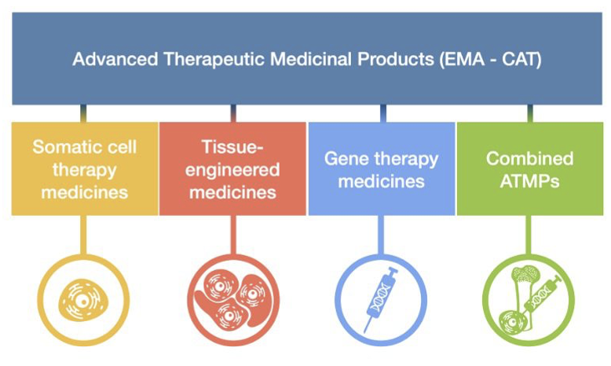
Advanced Therapy Medicinal Products (ATMPs): Redefining Therapeutic Frontiers
Overcoming the limitations of small molecule and Biologics, ATMPs will become effective new drugs for the treatment of complex diseases
ATMPs deliver targeted one-time cures for previously incurable diseases through transformative gene, cell, and tissue engineering
Advanced therapy medicinal products (ATMPs)
2020s-
ATMPs unlock the promise of science: curing the incurable, renewing hope, and rewriting medicine's tomorrow
Source: Frost & Sullivan， https://www.cevidra.com/advanced-therapy-medicinal-products/

Slide 4
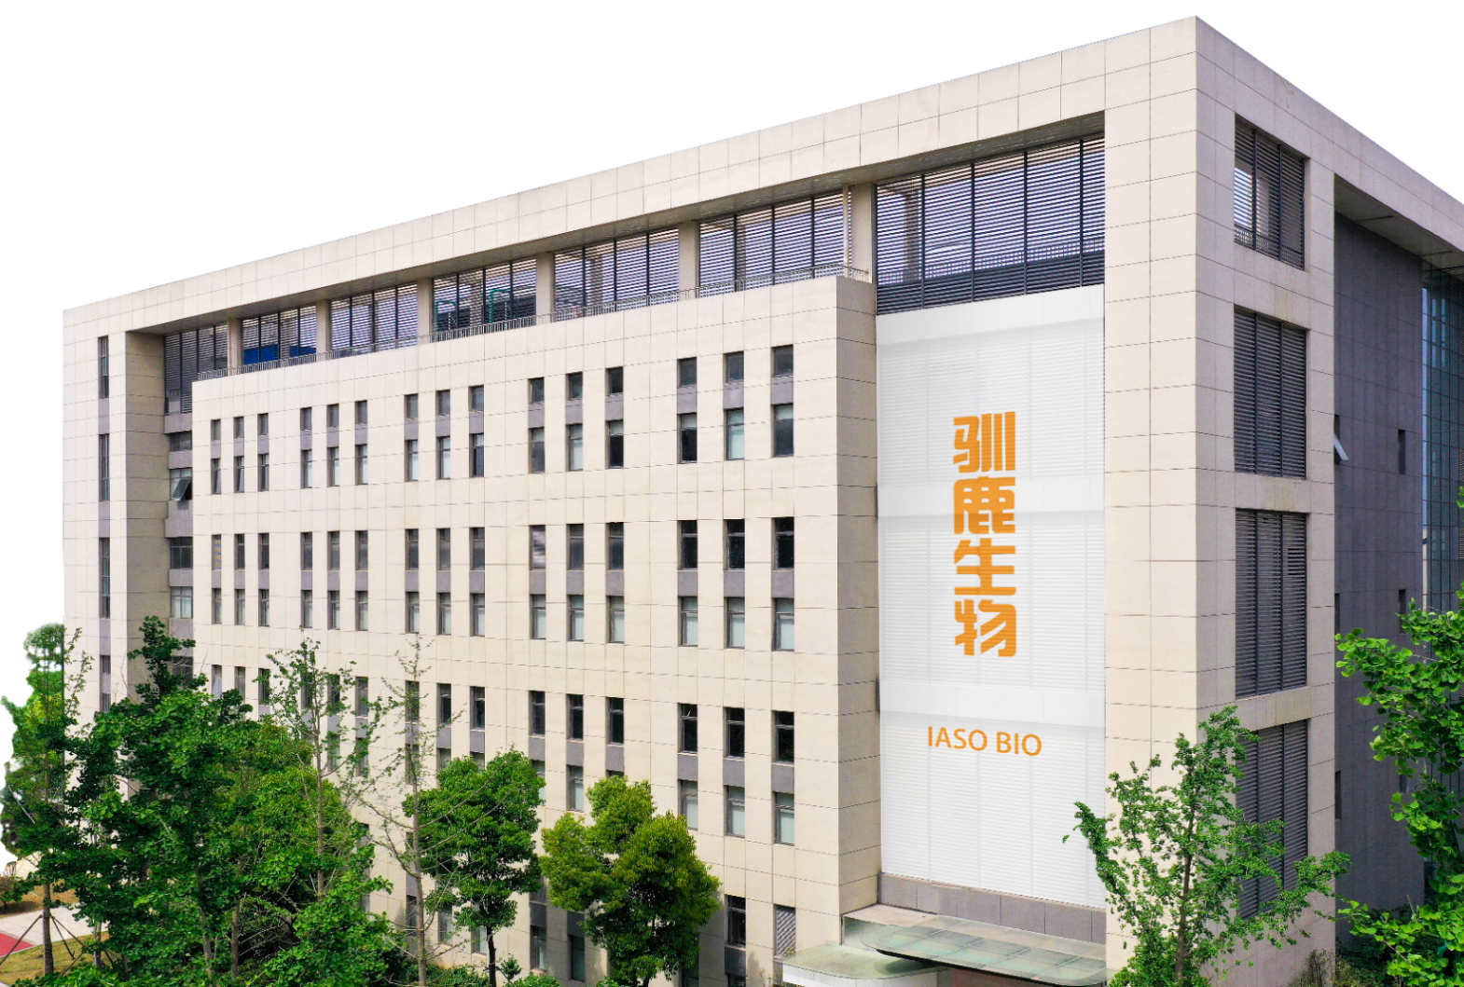



IASO Overview
IASO Bio is an innovation-driven advanced therapy company. Deeply rooted in hematologic malignancies and autoimmune diseases, it has expanded into therapeutic areas with unmet medical needs such as aging related diseases. Committed to transforming disease treatment paradigms, IASO leverages China’s capabilities to build a global industrial ecosystem, bringing curative hope to patients.
10 clinical pipelines ongoing with potential FIC/ BIC
Globalization
Rapidly expanding
Leading marketing position
10+pre-clinicial projects ongoing
4 sites in China & US
~9 Years 480+ employees
Dedicated team from discovery to commercial
TOP selling CAR-T
In China

Slide 5
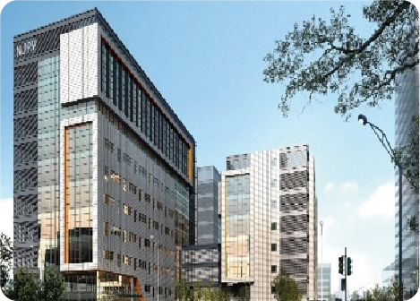
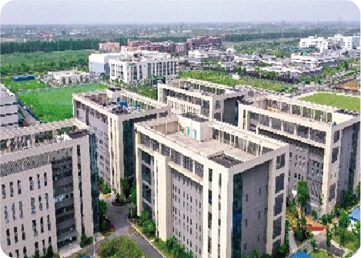
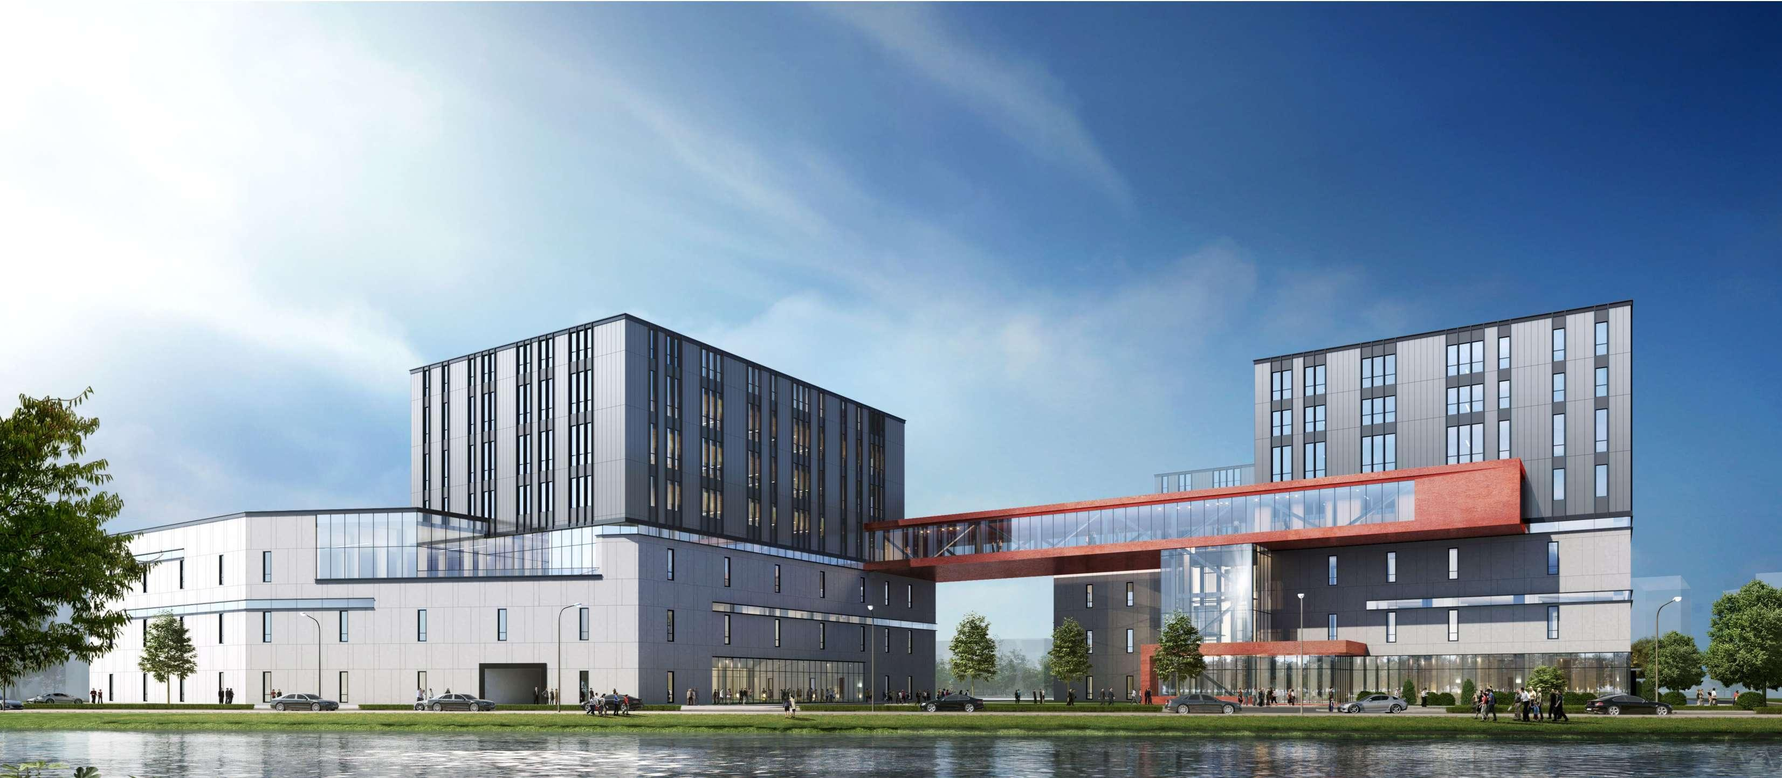
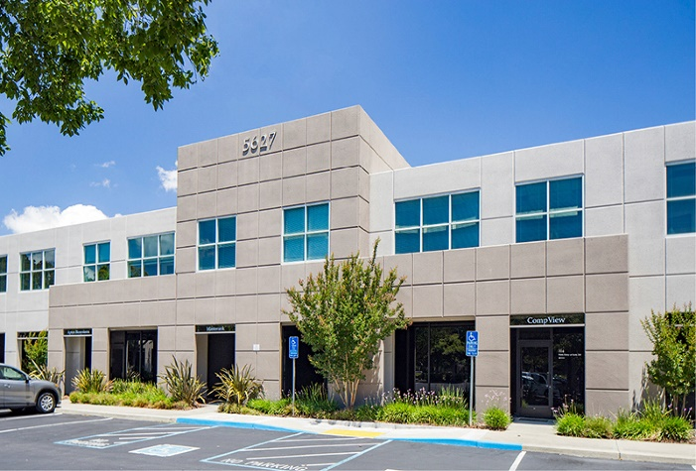




Global Footprint with International Competitiveness
Research and Clinical Manufacturing Site, Nanjing, China
GMP Manufacturing Site,
Nanjing, China
Global R&D, Commercial, and Manufacturing Site, Shanghai, China
US R&D Center, Pleasanton, California
Overseas cooperation
Collaboration on ex vivo allogeneic cell therapies and in vivo CAR-T therapies by combining Umoja’s cutting edge vivo vec and RACR technologies and IASO’s clinically validated binders
Licensed out BCMA construct for allogeneic cell therapies and in vivo CAR-T
Up to $204 million milestone payment
Licensed out CD19 binder for CAR-Ts targeting autoimmune diseases
Up to $162 million milestone payment
Exclusively license out the CAR-T therapy Fucaso (Equecabtagene Autoleucel) to the South Korean market for the treatment of multiple myeloma.
Notes:
Now we have 1 best-in-class commercial product and 10 products in clinical trials with ﬁrst/best-in-class potential and over 10 candidate products in development. We have 4 sites in Shanghai, Nanjing and the US.
This slide shows our 4 sites. The first one is our starting office which is an R&D Manufacturing Site in Nanjing. The Next is our GMP manufacturing which products lentiviral vectors, and CAR-T cells. This year We have opened our new International R&D Center in Shanghai, with an over 40,000-squar-meter facility. Additionally, our US R&D center locates in Pleasanton, California. We collaborate with SANA, licensed our CD19 CAR molecule to Cabaletta Bio for autoimmune diseases, and partner with Umoja on in vivo CAR-T technology.

Slide 6
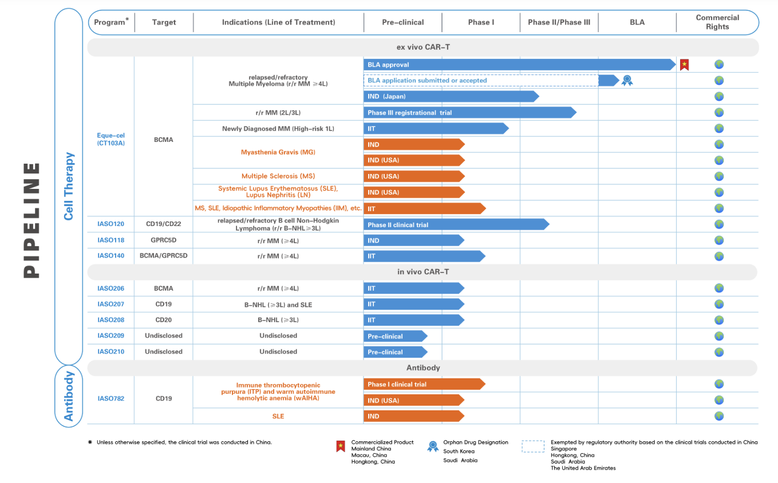
Pipeline

Slide 7
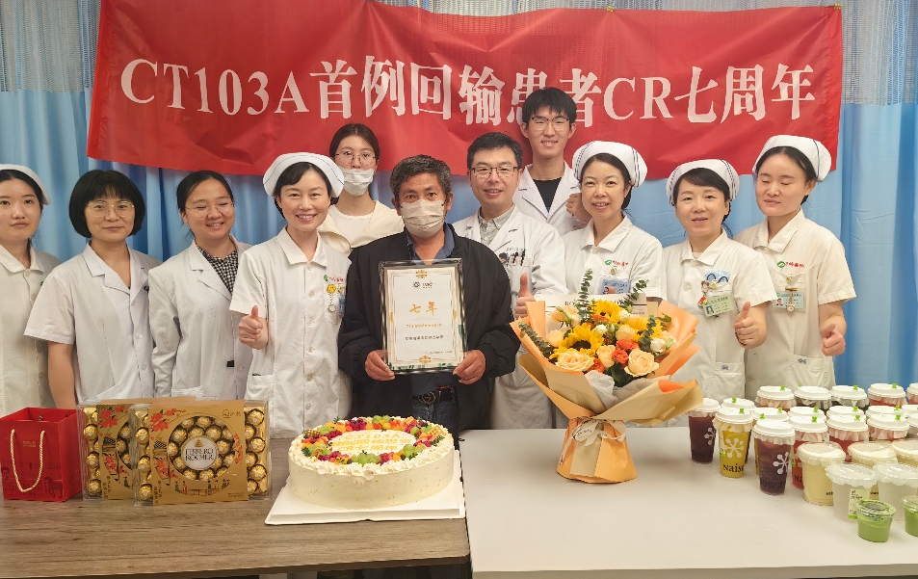

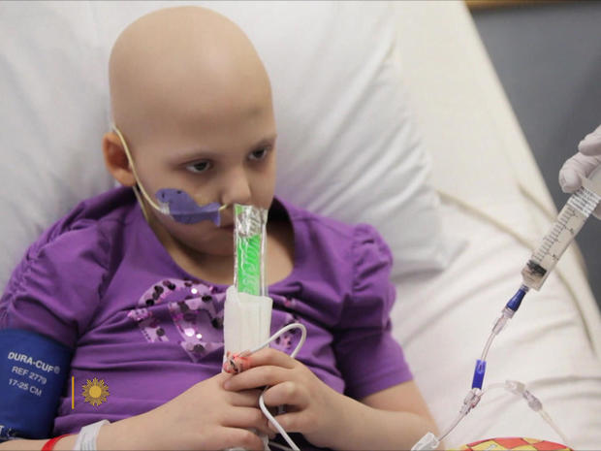
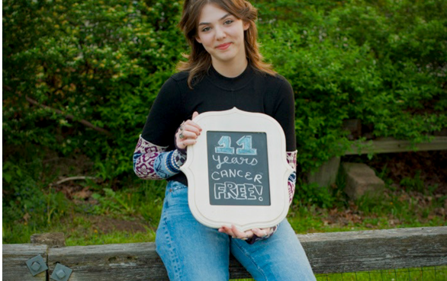
Hope Restored: ‘Our Emily’ Embraces a New Life after FUCASO®
Single dose/One time treatment for cure
7-year cancer free
(with FUCASO treatment)
Long term remission/Better life quality
In 2012, Emily became the first child in the world to receive CAR-T cell therapy in a breakthrough clinical trial.
Today, Emily is cancer-free and attends college at Penn State University.
A Story of a 44-year-old male, Farmer
Response after infusion (September 21, 2018)
Achieved sCR 14 days after infusion
sCR and MRD negative for more than 57 months
CRS and ICANS
Controllable Level 2 CRS
No ICANS
In May 2012, CAR-T was used to treat leukemia
In May 2023, Emily achieved 11-year cancer-free survival
*The first pediatric patient in the world to receive CAR T-cell therapy

Slide 8
Eque-cel – FIC and Potentially BIC BCMA CAR-T Therapy
Clinical Data Comparisons
Demonstrated clear advantages over other CAR-T cell therapies in multiple key measures
 | Fucaso® |  | Abecma® | Carvykti® | 赛恺泽® (Zevor-cel)
 | Patients without prior CAR-T N=97 | All patients N=109 | N=128 | N=97 | N=102
Approval | China Jun. 2023 |  | USA Mar. 2021 | USA Feb. 2022 | China Feb. 2024
Overall Response | 98.9% | 96.3% | 73% | 97.9% | 92.2%
≥CR | 88.4% | 83.2% | 33% | 82.5% | 71.6%
mPFS (months) | 35.9 | 30.5 | 8.8 | 34.9 | /
12-month PFS | 85.5% | 80.0% | / | / | 76.3%
CRS Grade ≥3 | 1.0% | 0.9% | 5.5% | 5.1% | 6.9%
CAR-T-associated Neurotoxicity (Including ICANS) ≥ Grade 3 | 0% |  | 4% | 11% | 0%
Parkinsonism | 0% |  | / | 5% | 0%
MDS Incidence Rate | 0% |  | 2/137 | 7/97 | 0%
AML Incidence Rate | 0% |  | 0% | 3/97 | 0%

Slide 9








Effectively Advance the Clinical Development and Registration of Eque-cel Globally
Advanced Market: USA and North America, Europe, Australia, East Asia……
Emerging Market: Southeast Asia, Mid East……
Great China: China mainland, Hong Kong, Macau……
From April to August 2024, we received IND approval from the U.S. FDA to conduct clinical trials of eque-cel in patients with MG, MS, and SLE/LN
In January 2025, the HSA accepted the BLA submitted by us
In July and August 2025, eque-cel was granted ODD and Priority Review Designation, respectively, by the MFDS
In October 2025, we received IND approval from the PMDA
In May 2025, the SFDA granted ODD; In July 2025, the BLA was accepted by the SFDA
In March 2025, Macau became the first jurisdiction outside Chinese mainland to formally approve eque-cel
In November 2025, the DOH approved the BLA for eque-cel, reinforcing Hong Kong’s role as a ‘‘frontline hub’’ in our localized registration strategy and international rollout
The BLA was accepted by the EDE
Notes:
Notes:
Now we have 1 best-in-class commercial product and 10 products in clinical trials with ﬁrst/best-in-class potential and over 10 candidate products in development. We have 4 sites in Shanghai, Nanjing and the US.
This slide shows our 4 sites. The first one is our starting office which is an R&D Manufacturing Site in Nanjing. The Next is our GMP manufacturing which products lentiviral vectors, and CAR-T cells. This year We have opened our new International R&D Center in Shanghai, with an over 40,000-squar-meter facility. Additionally, our US R&D center locates in Pleasanton, California. We collaborate with SANA, licensed our CD19 CAR molecule to Cabaletta Bio for autoimmune diseases, and partner with Umoja on in vivo CAR-T technology.

Slide 10







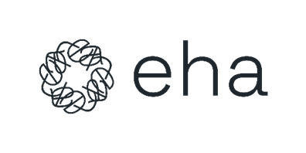
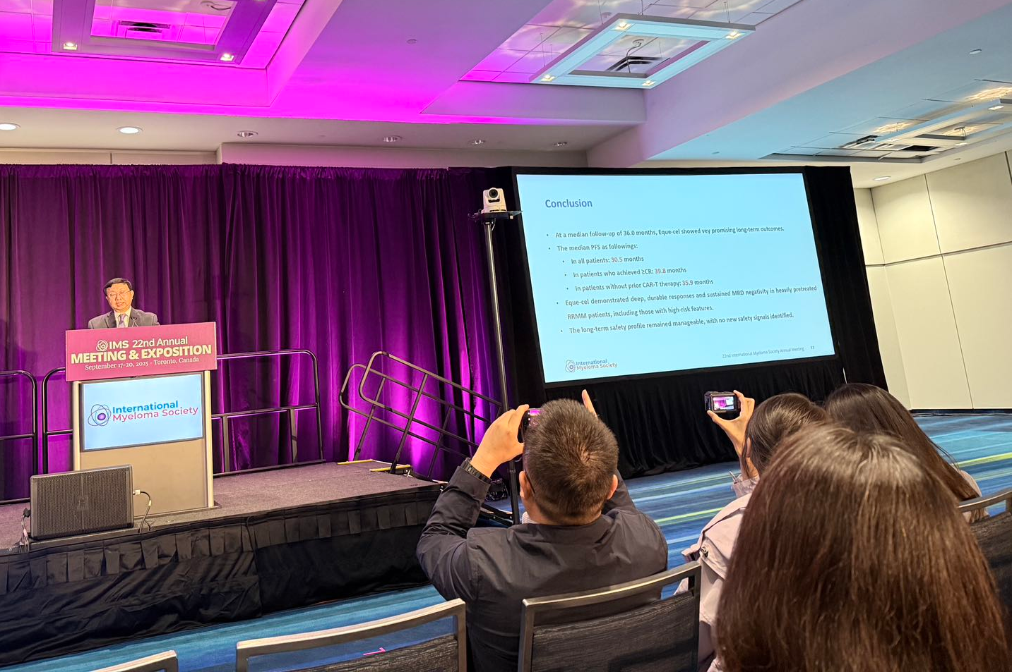
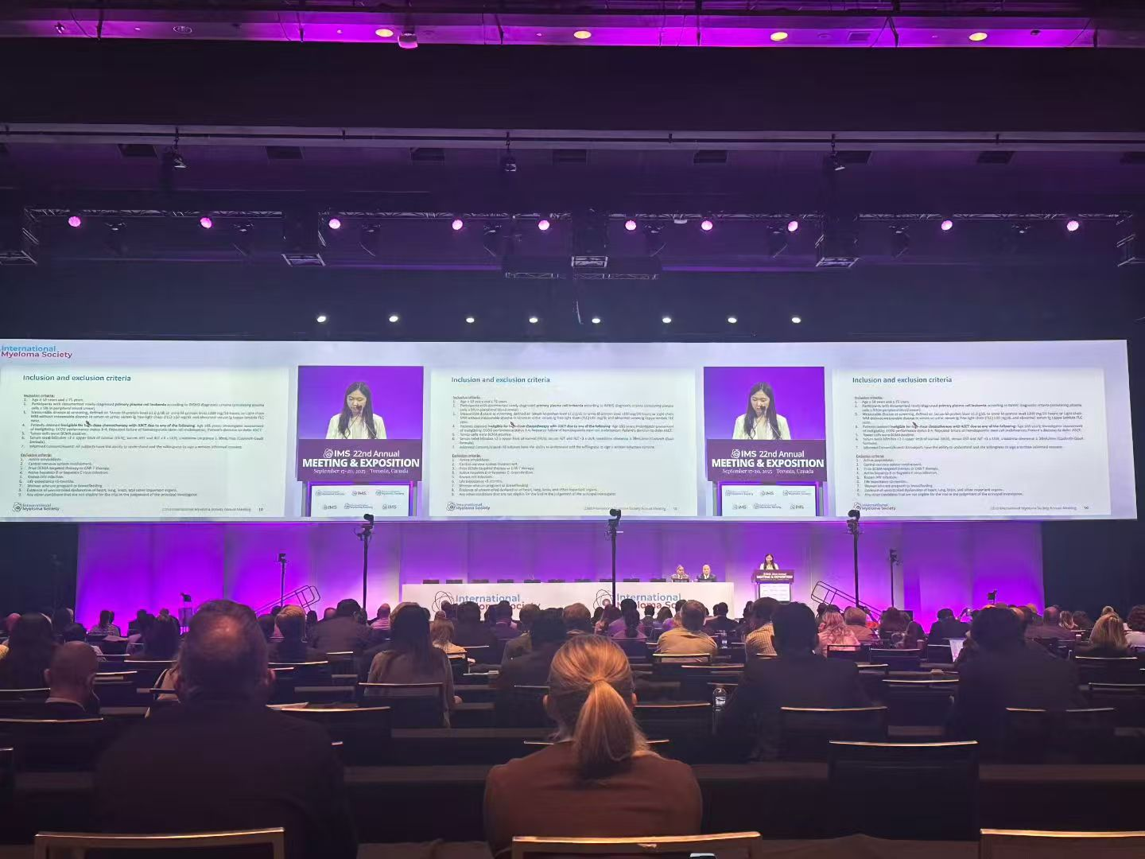



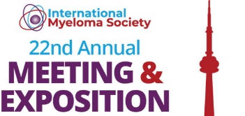
IASO as a well Recognized Innovator in the Field
25 +
1500+
Peer Review Publications
Total Citations
30 +
100 +
Oral Presentation in IMS
2025.09.18 Canada
36-month follow-up results
Oral Presentation in IMS
2025.09.19 Canada
1L pPCL results
Oral Presentations /Poster
Global Conference Attendance
Notes:
IASO Bio boasts a robust drug development platform, encompassing early discovery to clinical trials, regulatory approval, and commercialization. We have established the ﬁrst end-to-end fully cycle GMP CAR-T manufacturing facility in China, and the GMP manufacturing site is now in Nanjing. Thus, we have all the certificates and hundreds of patents.

Slide 11
Thanks!
Nov 2025

